Slide 1
Welcome to COMP 285
Lecture 0: Welcome + Course Logistics
COMP - 285
Advanced Analysis of Algorithms
Chris Lucas (cflucas@ncat.edu)
Notes:
Hi everyone, welcome to the zeroth lecture for COMP 285 Algorithmic Analysis
A couple of ground rules:
Raise your hands whenever questions come up; don’t worry about waiting for me to ask if there are any questions.
Also, I’ve been told that sometimes I can start speaking too quickly, especially when I’m getting excited about something so if I start speaking too quickly, please point upwards and I’ll slow down. Use the index finger, maybe don’t flip me off, cool cool.

Slide 2

Big Questions!
08/18/22 - Session
Who are we?
Why are we here?
Where do we want to go?
What’s going on?

Slide 3

Big Questions!
08/18/22 - Session
Who are we?
Why are we here?
Where do we want to go?
What’s going on?

Slide 4
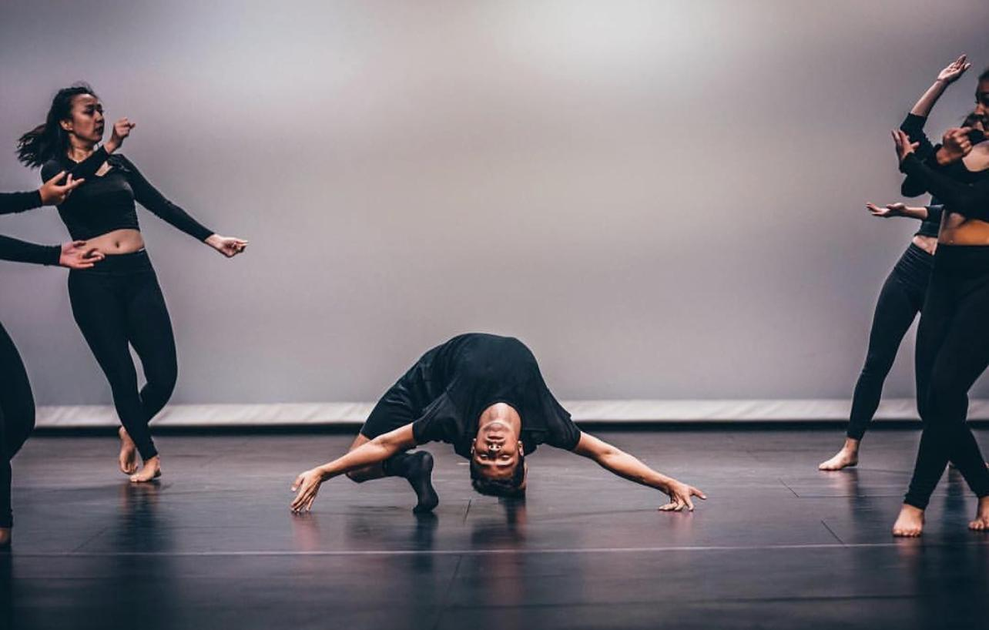
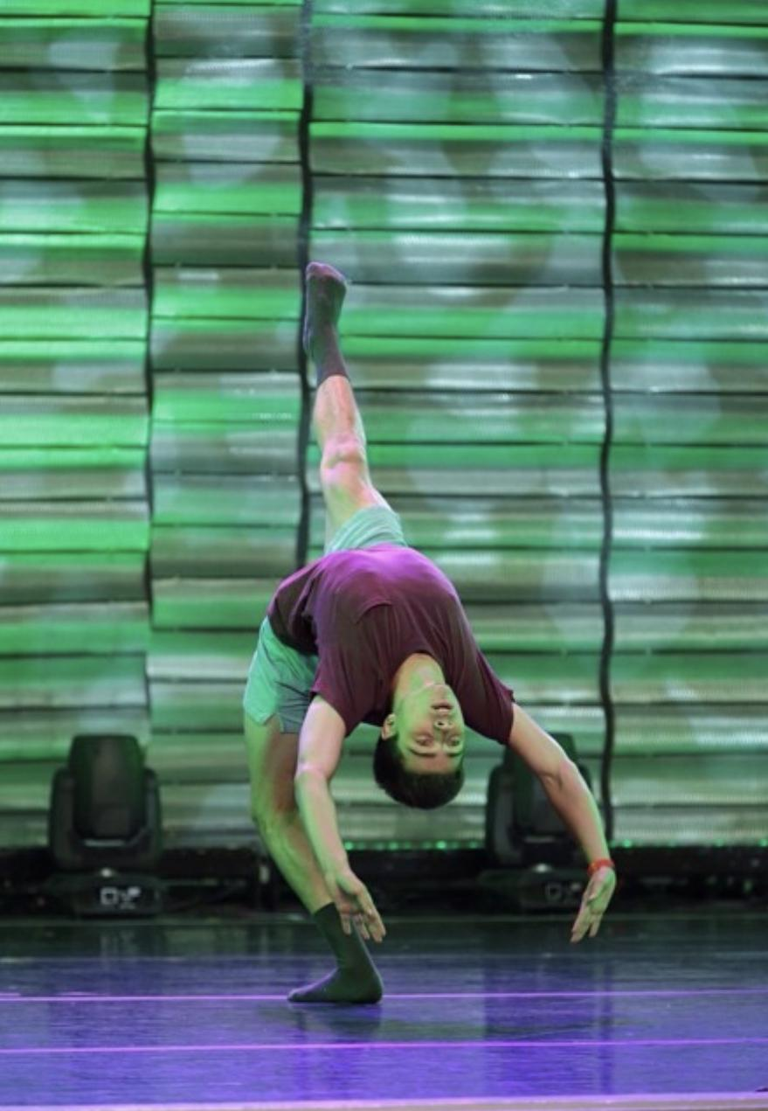

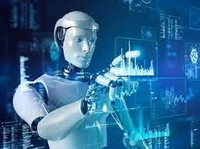
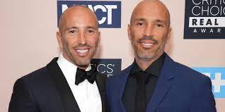
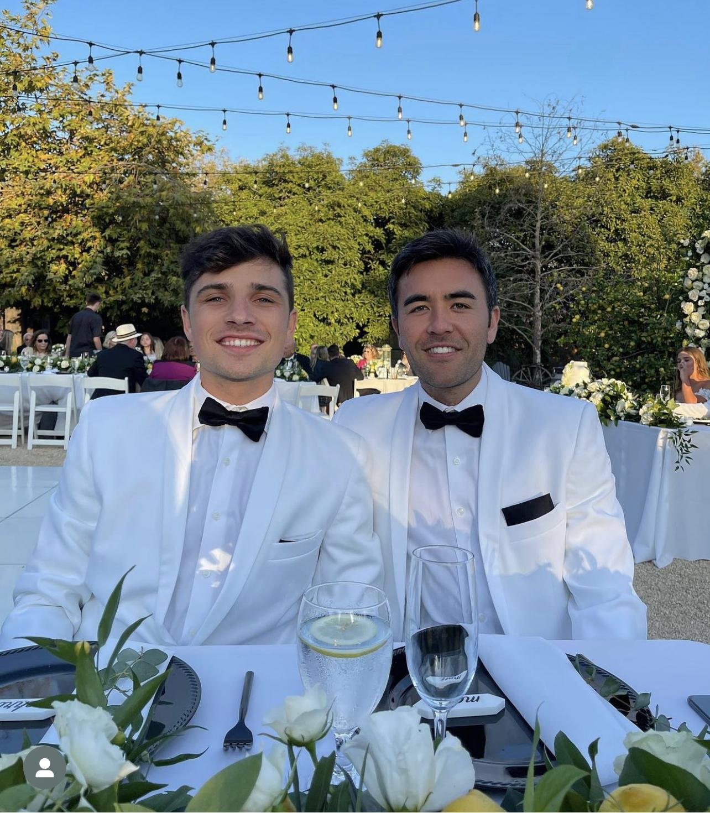
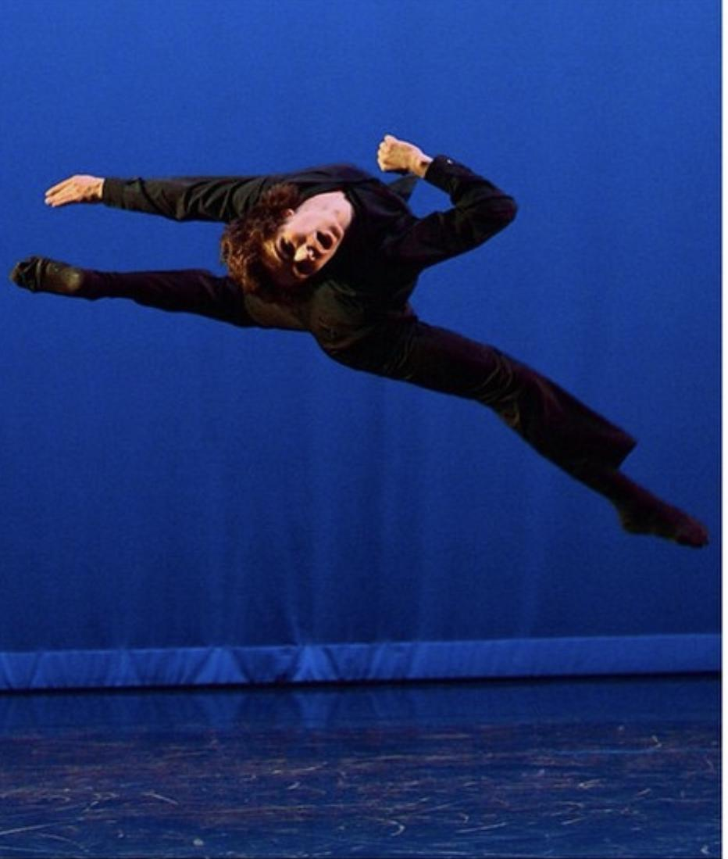


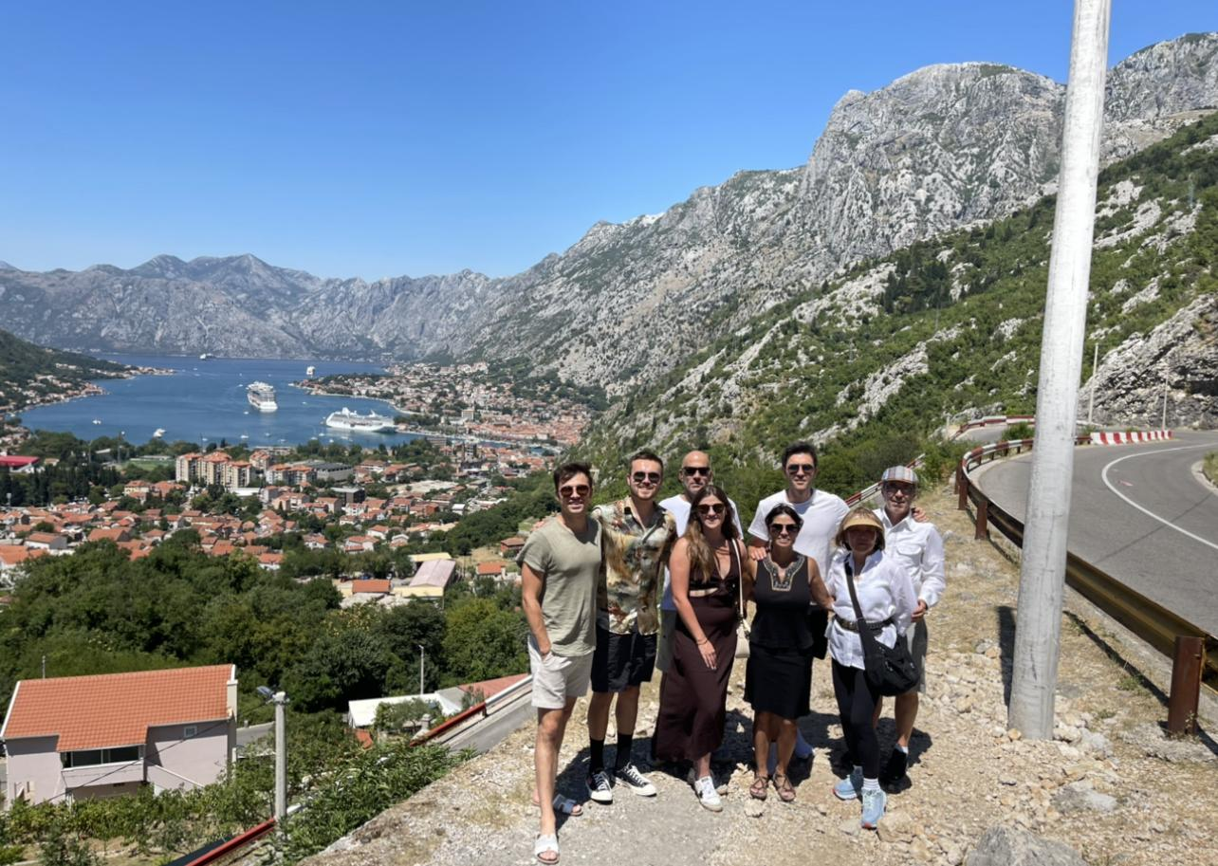

Who am I?
Notes:
My name is Chris, I’m from Los Angeles, probably the most “interesting” thing about me is that I danced for many years, my whole childhood and through college. It was really my first love in life. Grew up in a public school system that didn’t have computer science education so I didn’t know about it for a very long time. I thought of it as how we colloquially think of rocket science, you know that saying it’s not like it’s rocket science. My life was headed in a very different direction until I tripped and fell into computer science later in college and it really changed my life. So enough about me, who are you?

Slide 5
Who are you?
Notes:
How was your summer? Are you happy to be back in class? Etc. Where are you from?

Slide 6
Who are you?
Preview for HW 0!
(Released by end of day)

Slide 7
Big Questions!
08/18/22 - Session
Who are we?
Why are we here?
What’s going on?
Where do we want to go?

Slide 8
Motivations for this Course!

Slide 9
Motivations for this Course!
Why are you here?
Algorithms are fundamental
Algorithms are fun
Algorithms are useful

Slide 10
Motivations for this Course!
Why are you here?
Algorithms are fundamental
Algorithms are fun
Algorithms are useful
This course is required

Slide 11
Motivations for this Course!
Why are you here?
Why am I here?
Algorithms are fundamental
Algorithms are fun
Algorithms are useful
This course is required
I love algorithms and computer science!
I love teaching!
I want to help you succeed

Slide 12
Motivations for this Course!
Why are you here?
Why am I here?
Why is this course required?
Algorithms are fundamental
Algorithms are fun
Algorithms are useful
This course is required
I love algorithms and computer science!
I love teaching!
I want to help you succeed
Algorithms are fundamental
Algorithms are fun
Algorithms are useful
Algorithms are core to interview process

Slide 13

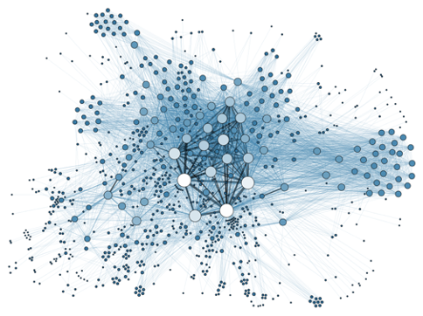



Algorithms are Fundamental
Operating Systems (COMP 350)
Internet Systems (COMP 322)
AI & Machine Learning (COMP 365)
Applied Network Security (COMP 420)
Computer Architecture (COMP 375)
Notes:
Algorithms are fundamental to your academic career… you will need learnings from this course in order to go on to study a multitude of things within computer science

Slide 14

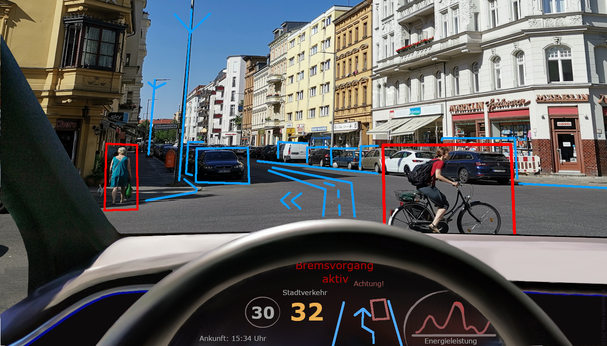



Algorithms are Useful
Social Media
Autonomous Driving
e-Commerce
Google search, internet browsing,
Know the algo behind page indexing?
Finance/equity trade
Notes:
Perhaps slightly more interesting, would be how algorithms are fundamental to and useful for the world around you…
social media (i worked at Instagram and have had my hands on some of the algorithms that power the app directly,
e-commerce (TRILLIONS OF DOLLARS, payment system, item find and retrieve, item recommendation are all based on algorithms),
google search and the broader internet, (organizing content on the internet)
autonomous driving (companies such as tesla or waymo employ very advanced algorithms rooted in AI to accomplish this).
The word algorithm doesn’t even have to be technical or rooted in software, “algorithm” the word just refers to a series of steps or processes to be followed in order to achieve some task or goal. So even something like a cooking recipe is an example of an algorithm.
They are so ubiquitous and so exciting because of the impact you can have in virtually any domain.
Core body of knowledge:
Biology (gene sequencing)
Robots/AV (parallel parking, whipping donuts at 120mph)
AI/RL (how to teach computers to make decisions when there’s uncertainty), (AlphaZero AI algorithm taught itself chess in 4 hours and instantly beat the world champion)
Film production/Graphics (got amazing device that can crunch numbers and perform matrix operations at blindingly fast speeds, how can we leverage that for something that’s aesthetically appealing? How can we model the real world and then augment that with fantastical elements?)
The point is you can take what you learn here and really go on to effect the change in the world that you want.

Slide 15
Algorithms are fun!
More an art than science
Requires a lot of creativity
Many surprises!
Still a new field!
Many exciting and new research and applications!
Notes:
Believe it or not, algorithms are also fun! I may be a bit biased here, but it’s an ever evolving field at the forefront of computer science and the industry.
Cool, smart people are figuring out cool ways to do things cool, smart things.
One of the algorithms we’ll talk about next lecture had its newest advancement for more efficient ways of programming it discovered in 2019.
So I guess my point is this that isn’t just a bunch of crusty old computer scientists from decades ago who came up with a bunch of outdated stuff for us to learn.
(Pause for questions)

Slide 16
Big Questions!
08/18/22 - Session
Who are we?
Why are we here?
Where do we want to go?
What’s going on?
Notes:
Getting into where is this course going, what you can expect from upcoming few months…

Slide 17
The Purposes of this Course
This course is meant to meet you where you are, challenge you, and uplevel your engineering skills.
This course is meant to teach you teach you how to reason about algorithms, how much time and space they consume, how to solve problems with algorithms.
This course is meant to prepare you to navigate applying to internships/jobs and what ensues thereafter.
Notes:
Read each one…
I alluded to the third bullet here a bit earlier when I mentioned algorithms being core to the interview process, but we’re going to allocate a decent chunk of our bandwidth towards career prep which we’ll get into in more detail later.

Slide 18
Our Course Map!
Building Blocks of Algorithms
Trees of all kinds
Sorting Algorithms
Graphs + Graph Algorithms
Advanced Algorithms
Notes:
Okay so how will we get there? This is a rough outline of the concepts we’ll cover in the following sequence…

Slide 19
Our Course Map!
Building Blocks of Algorithms
Recursion
Big-O (time/space complexity)
Data structures (stacks, queues, maps, sets, etc.)
General problem solving methodology
Notes:
Building blocks of algorithms

Slide 20
Our Course Map!
Building Blocks of Algorithms
Sorting Algorithms
How to arrange and “sort” data in data structures
Mergesort, InsertionSort, QuickSort
Master Theorem, linear sorting approaches
Notes:
Sorting algorithms … just what it sounds like.. Learning different ways we sort/arrange data, manipulate data structures

Slide 21
Our Course Map!
What is a tree?
BSTs
Self-balancing trees
Topological sorting
Building Blocks of Algorithms
Trees of all kinds
Sorting Algorithms
Graphs + Graph Algorithms
Graphs, nodes, edges
Depth and breadth first searching, Dijkstra’s, A*
Notes:
Trees and graphs are considered slightly more advanced data structures than what we will have seen up until that point. And there are various algorithms and concepts that go along with each that we’ll examine.

Slide 22
Our Course Map!
Building Blocks of Algorithms
Trees of all kinds
Sorting Algorithms
Graphs + Graph Algorithms
Advanced Algorithms
Greedy algorithms
Dynamic programming
P v. NP complete problems
Notes:
Advanced algorithms,
greedy algorithms (greedily making the optimal decision for that moment, not concerned with finding the global optimum e.g. network routing, message is sent to whatever node is closest to the destination),
dynamic programming,
P vs NP complete (a bit of theory, basically how we classify a problem’s “solvability”, e.g.factoring a large integer, easy to verify if a solution is correct, difficult to solve, don’t have an algorithm that can do so efficiently),

Slide 23
Our Course Map!
Building Blocks of Algorithms
Trees of all kinds
Sorting Algorithms
Graphs + Graph Algorithms
Advanced Algorithms
Career Preparation
Notes:
Then want this presence of career prep sort of filled throughout.. That’s things like:
Writing a compelling resume
Preparing for interviews
General how to get an internship or job
How to optimally position ourselves in the eyes of a recruiter
I want us to be thinking about career prep over the entire course. I think this is important to know:
based on my firsthand experience of not knowing any of this and not having access to this information when I was in college and then
this was well received by students in previous iterations of this course, so I wanted to double down on this.

Slide 24
Our Course Map!
Building Blocks of Algorithms: problem-solving skills, time and space complexity analysis, recursion, using basic data structures
Sorting algorithm: Merge-, Insertion-, Quick-sort, Master Theorem, O(n) sorting
Trees & Graphs: tree and graph traversals, self-balancing binary search trees, topological sorts, weighted graphs, Dijkstra’s, minimum spanning trees
Advanced Topics: greedy algorithms, dynamic programming, P vs NP, approximation algorithms.
Career Prep: resume building, preparing for technical interviews, how to apply to internships/jobs
Notes:
If you’re not a visual learner, here’s that same information in text… it’s also included on the course syllabus
(pause for questions)

Slide 25

Concrete Examples
Notes:
I wanted to walk through some concrete examples of how we can apply the topics we’ll learn and bring this material to the forefront of the discussion

Slide 26
Disaster Planning

Slide 27
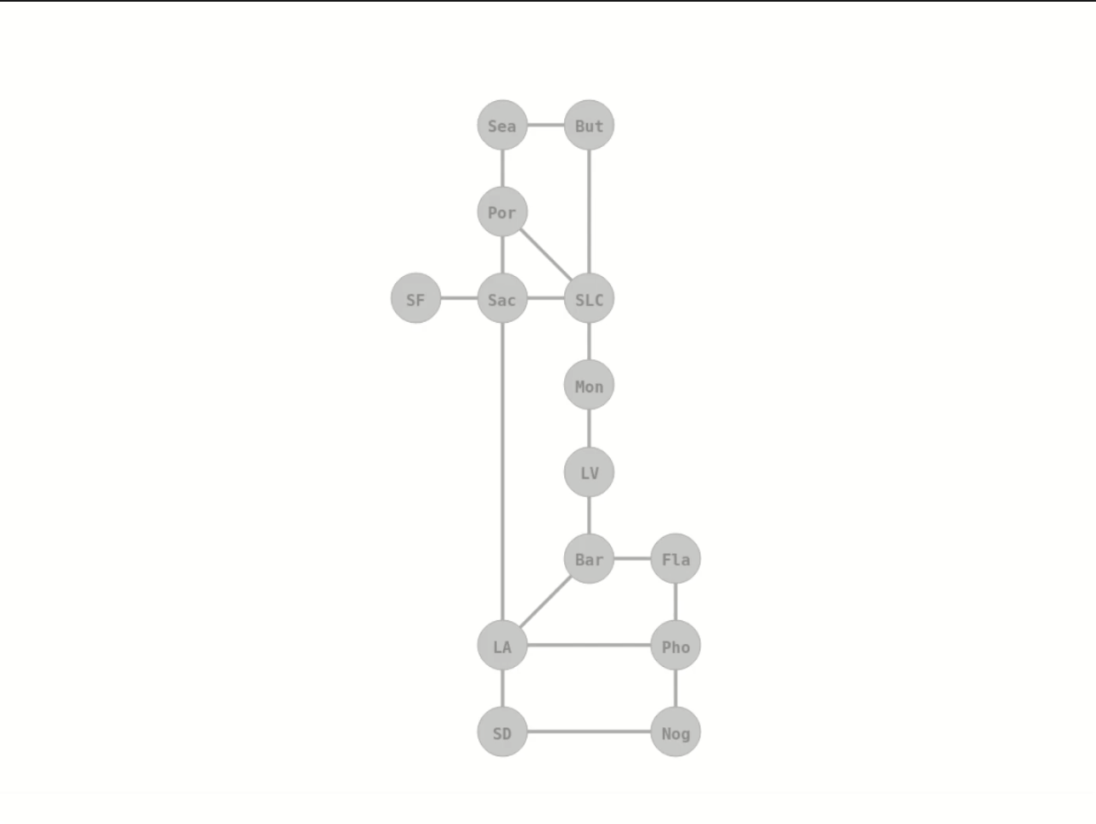

Slide 28
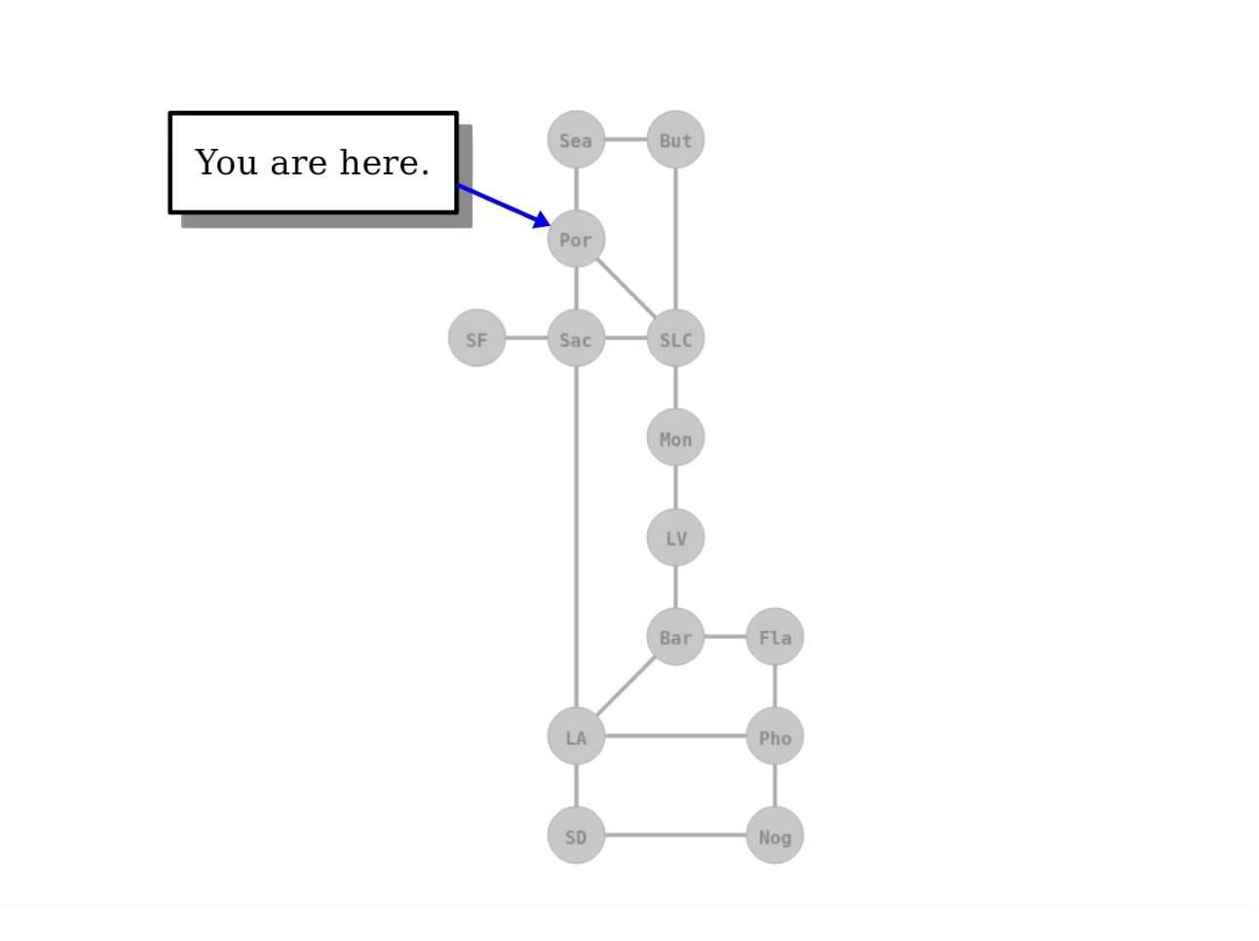

Slide 29
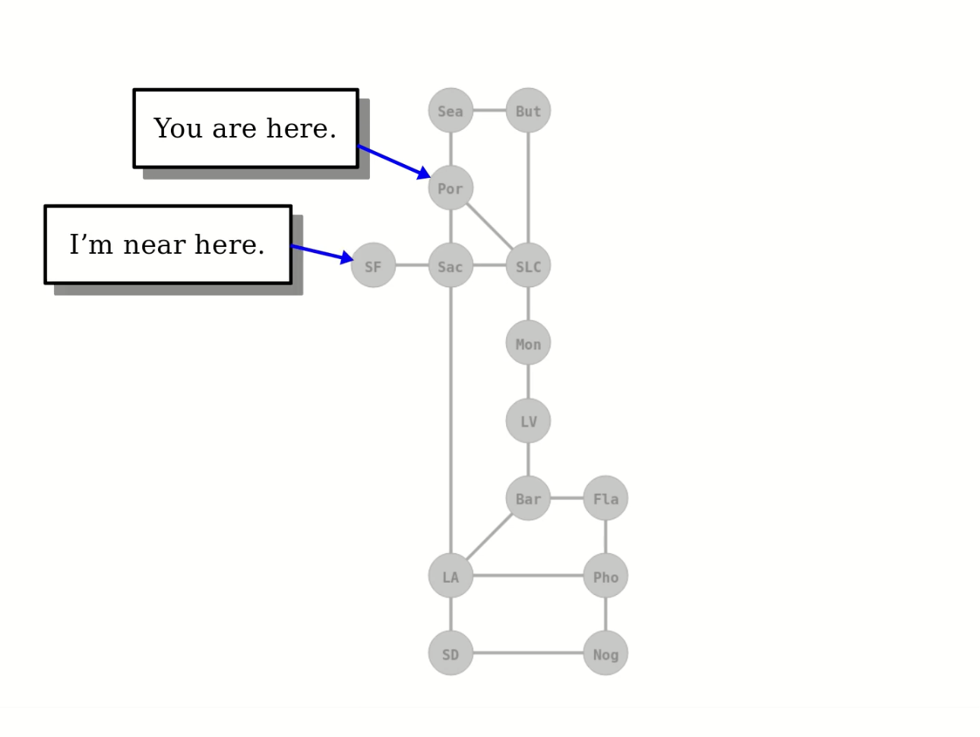

Slide 30
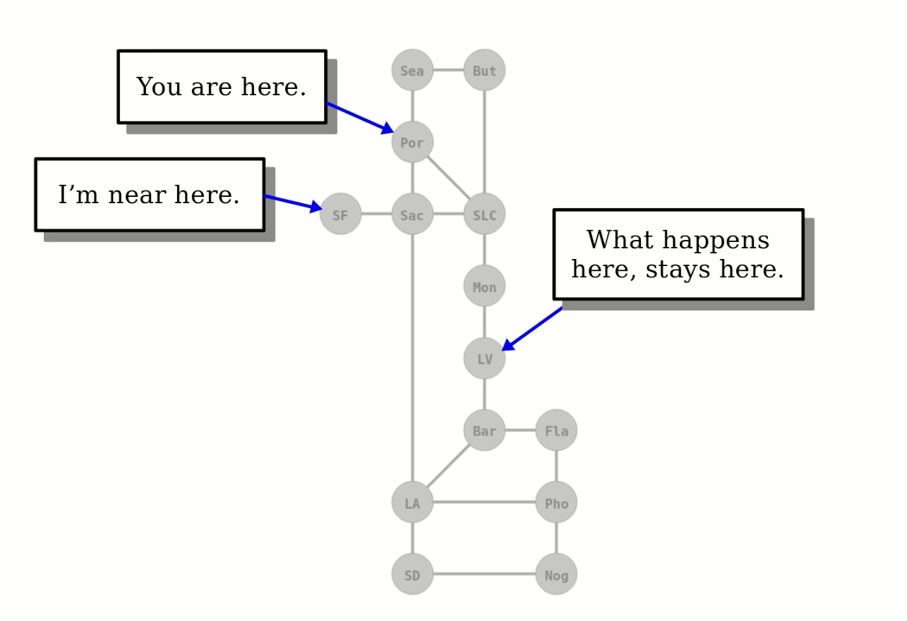

Slide 31
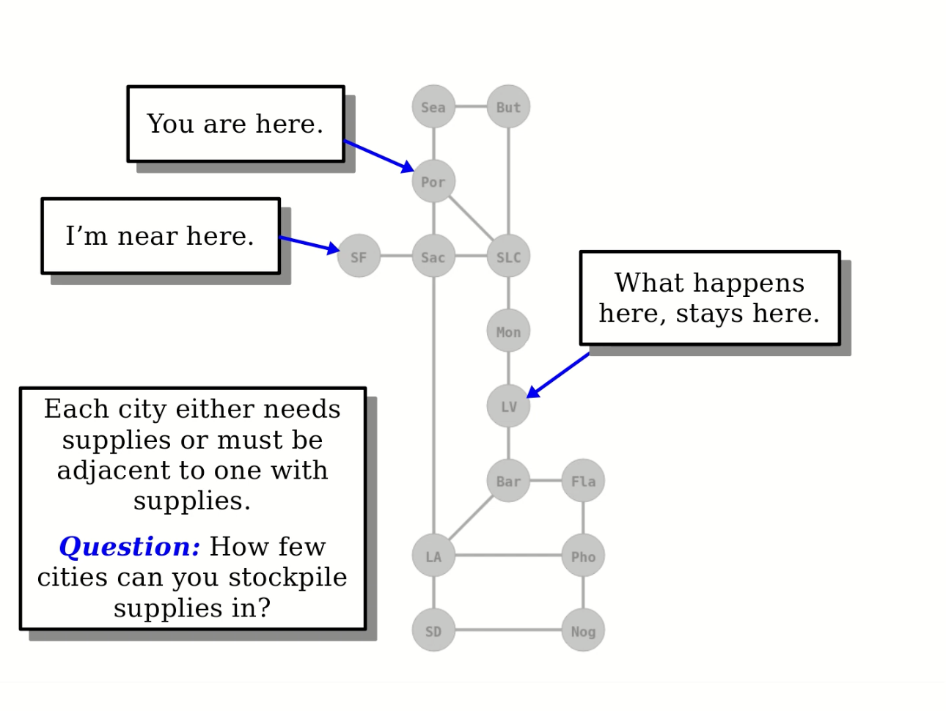
Notes:
Hopefully this is a problem we all feel some level of compulsion to solve given the gravity of the circumstances… but this really just boils down to recursive backtracking - an algorithmic principle we’ll cover later in this course.

Slide 32
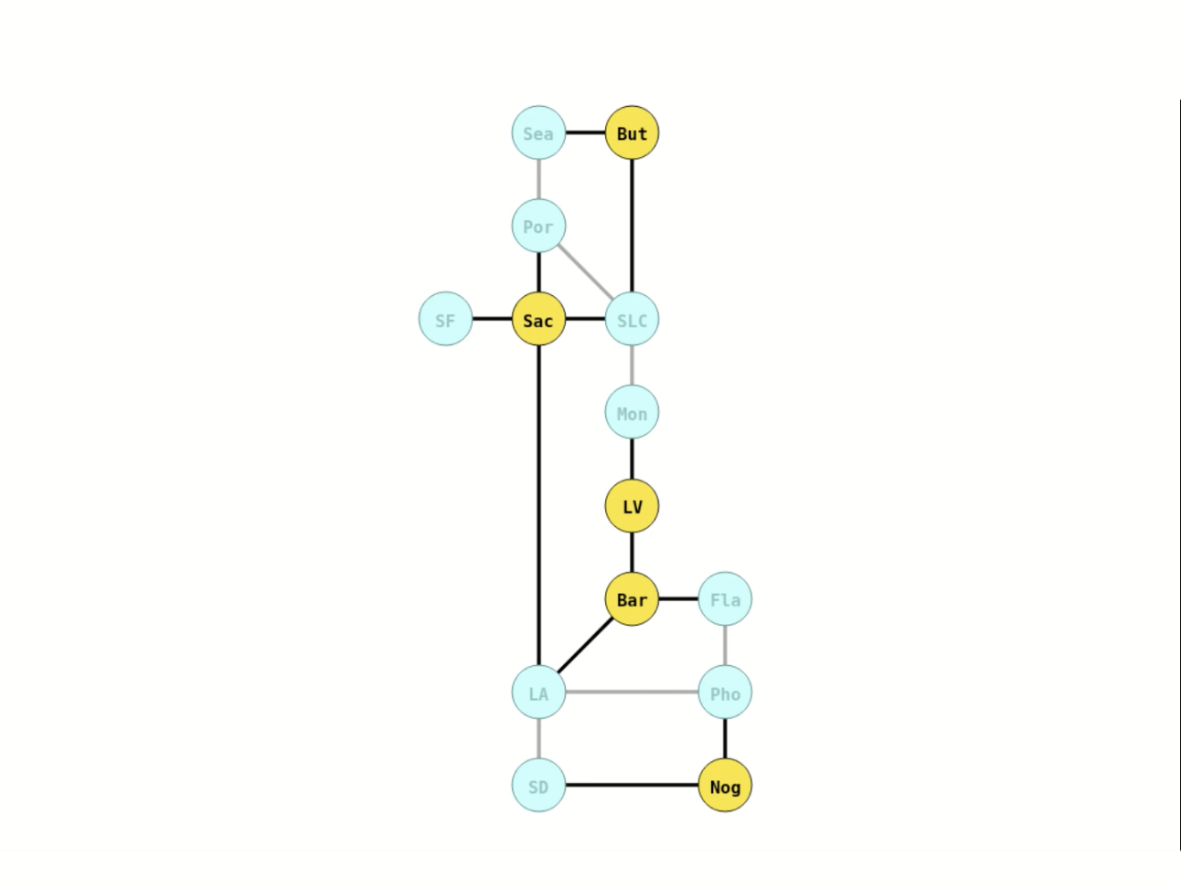

Slide 33
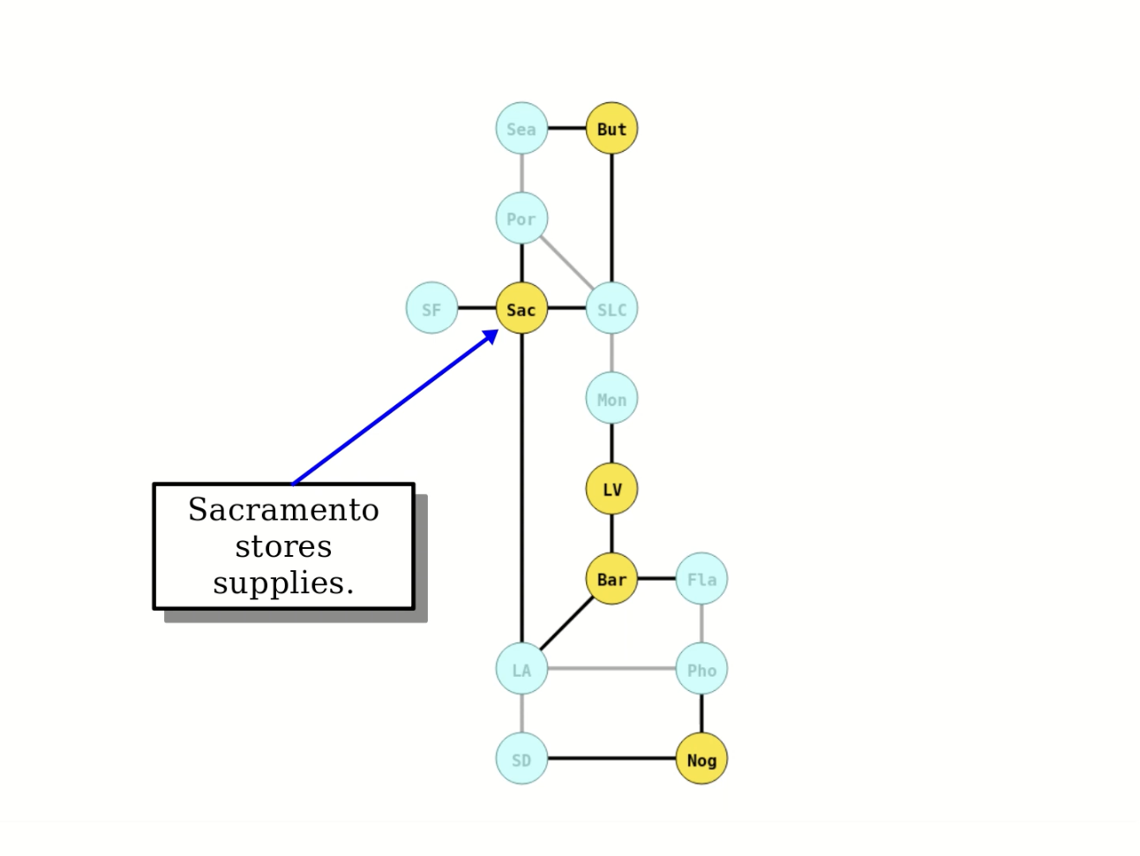

Slide 34
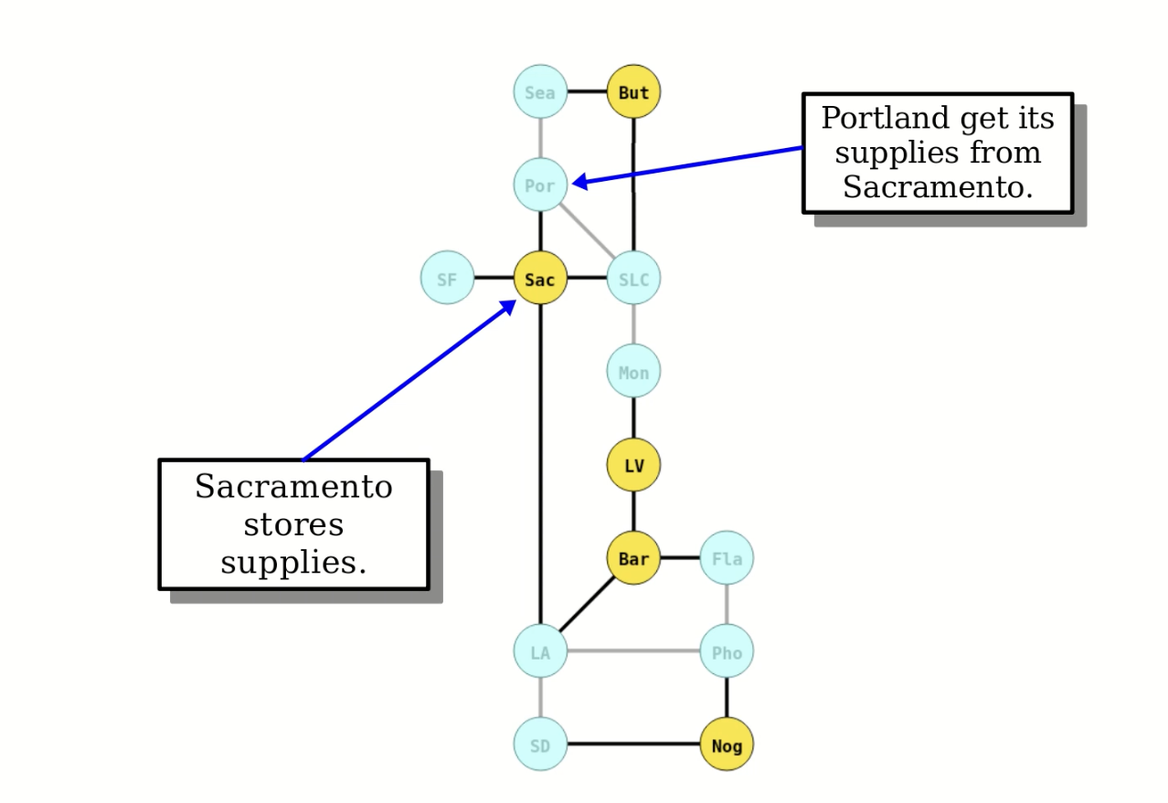
Notes:
You could eyeball this and maybe come up with a solution close to this, but even then it’d be difficult to ensure you have the most optimal answer.
It gets a bit unwieldy with a larger map.

Slide 35
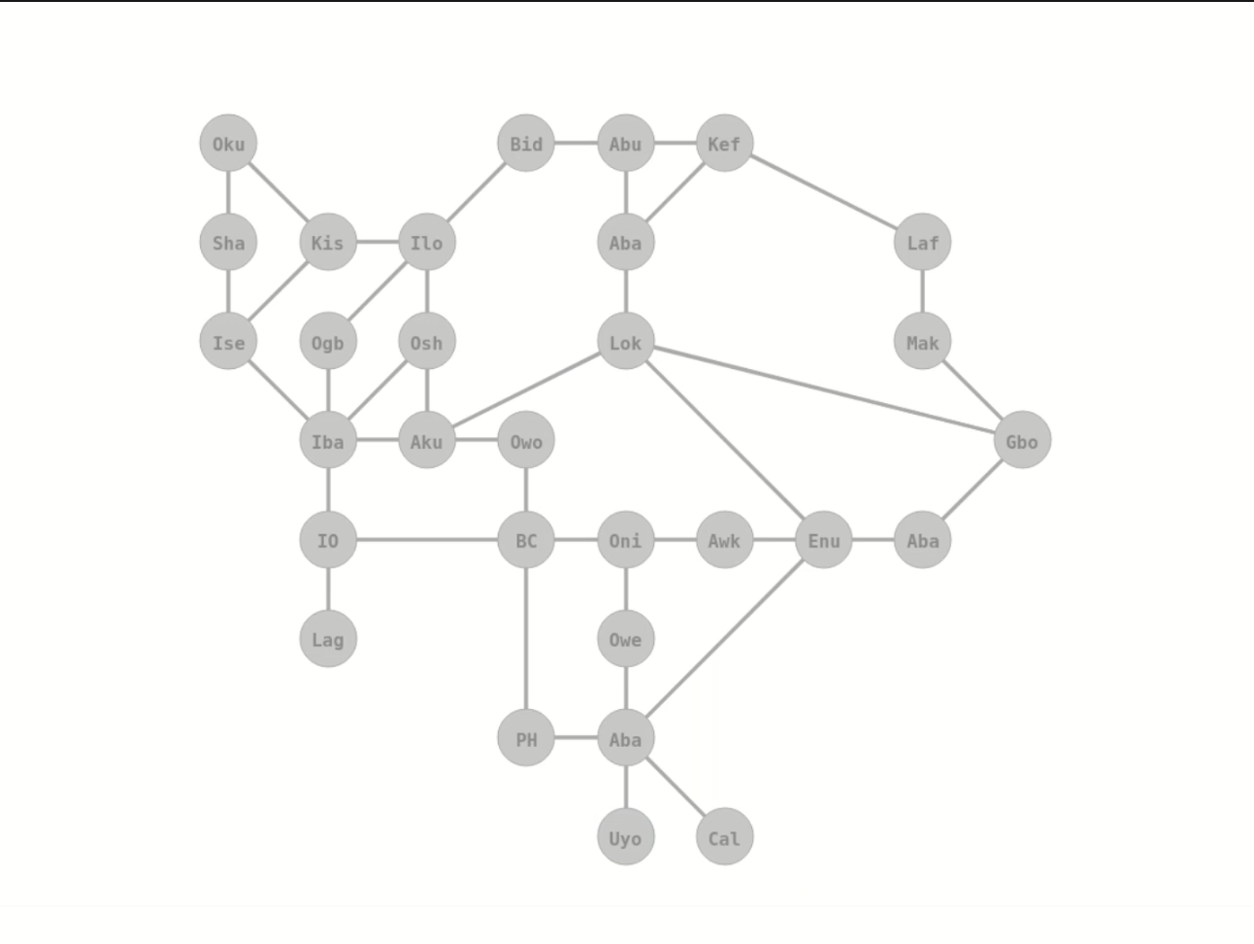
Notes:
Southern Nigeria

Slide 36
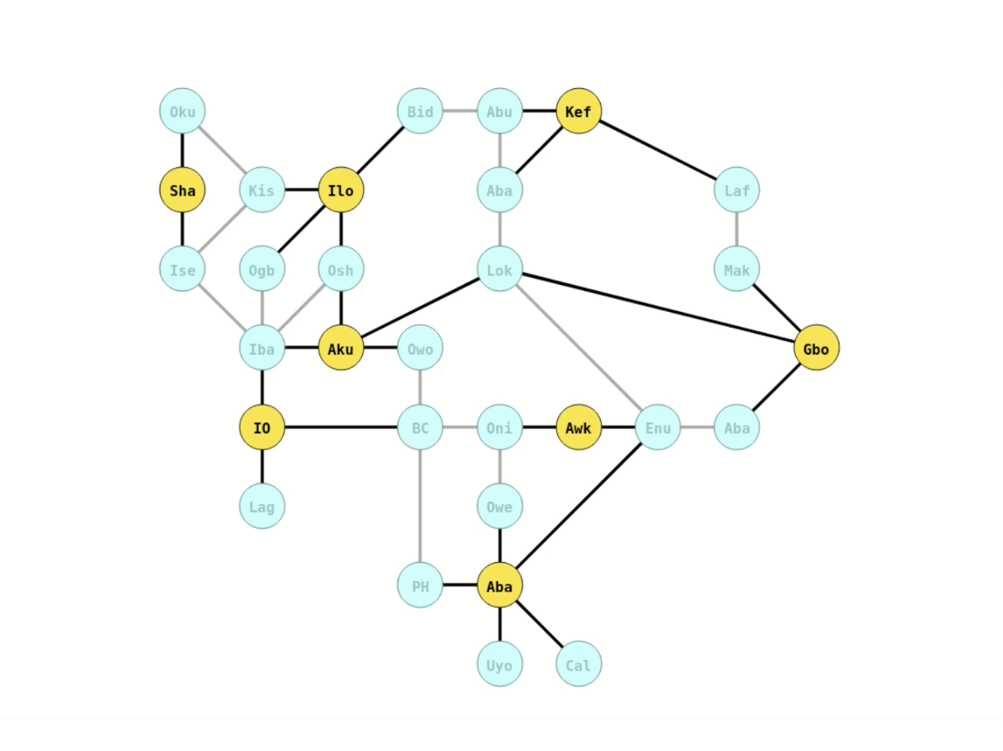
Notes:
Southern Nigeria, 8 cities, go ahead and take a look at this, notice how each node or city is either gold or gold-adjacent

Slide 37
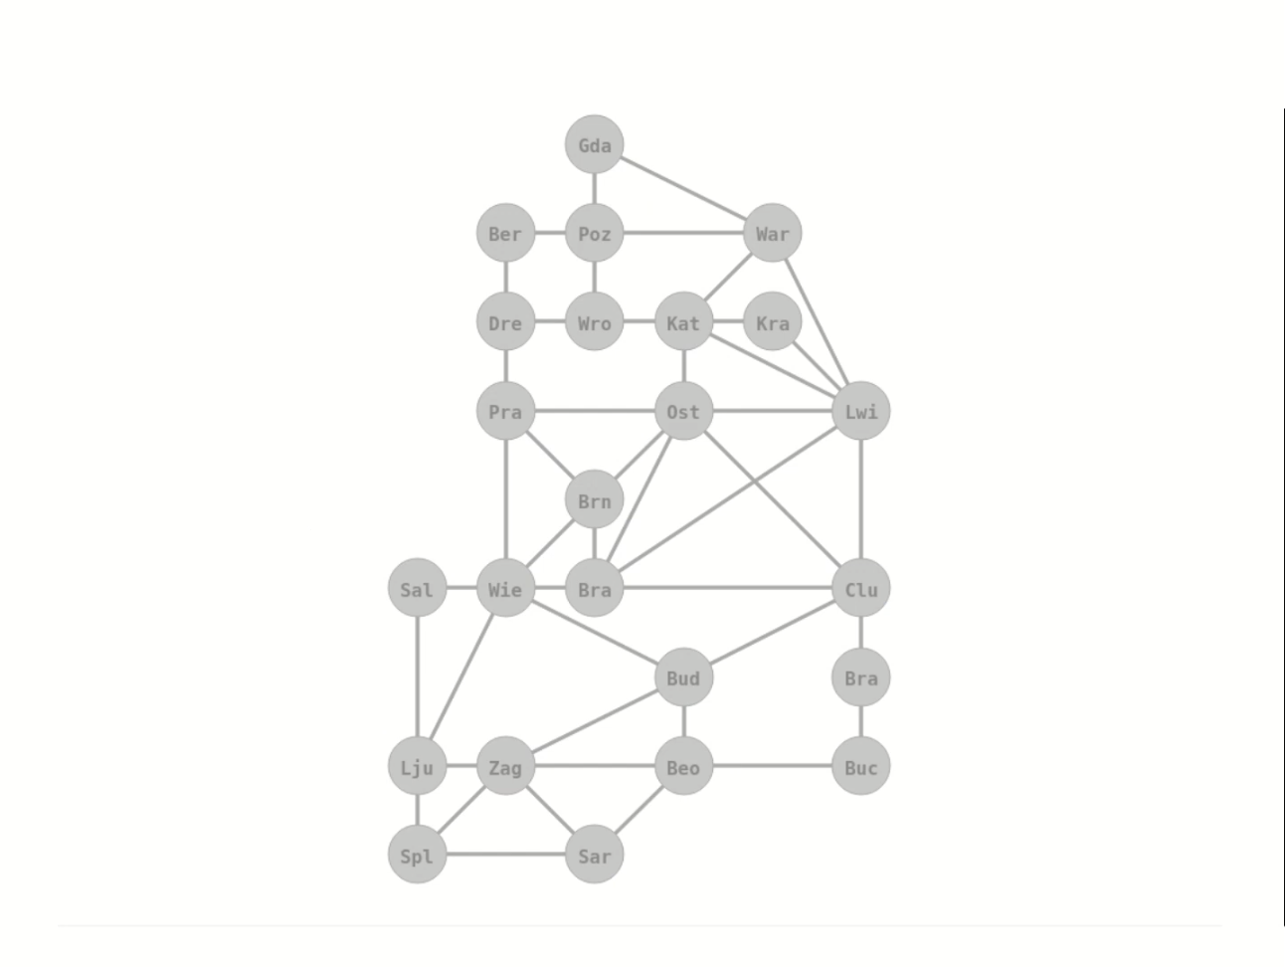
Notes:
Central Europe

Slide 38
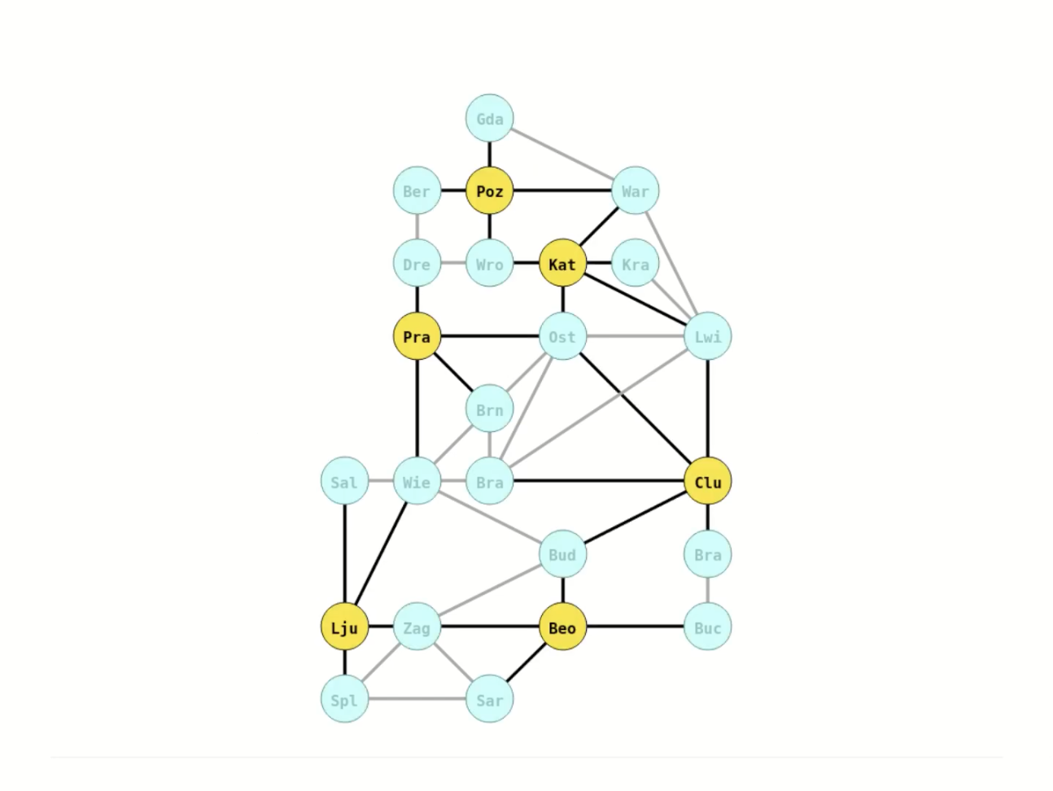
Notes:
Central Europe, 6 cities, you could imagine applying similar techniques to your hometowns (Max in Texas, or Priscila in Wisconsin) and contribute to public health and safety which is really powerful and meaningful.

Slide 39
Doctors Without Orders

Slide 40
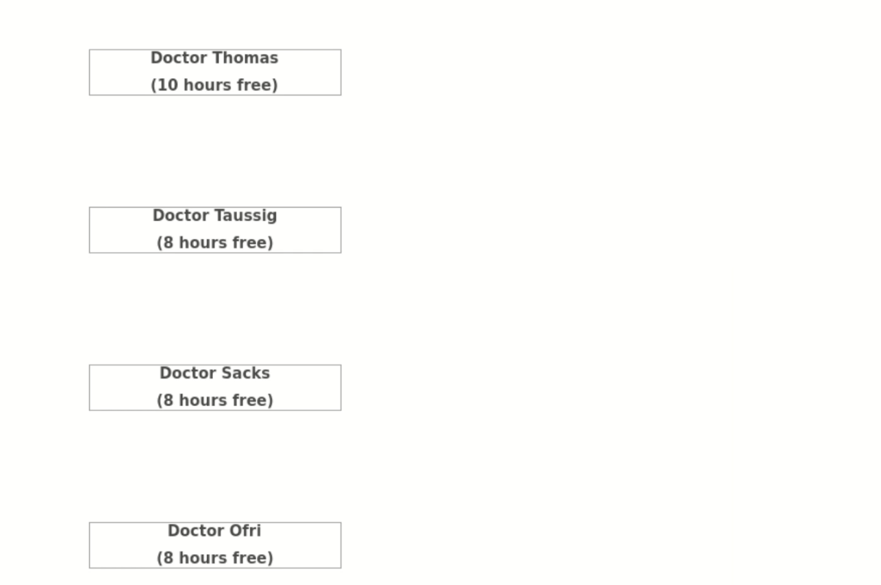

Slide 41
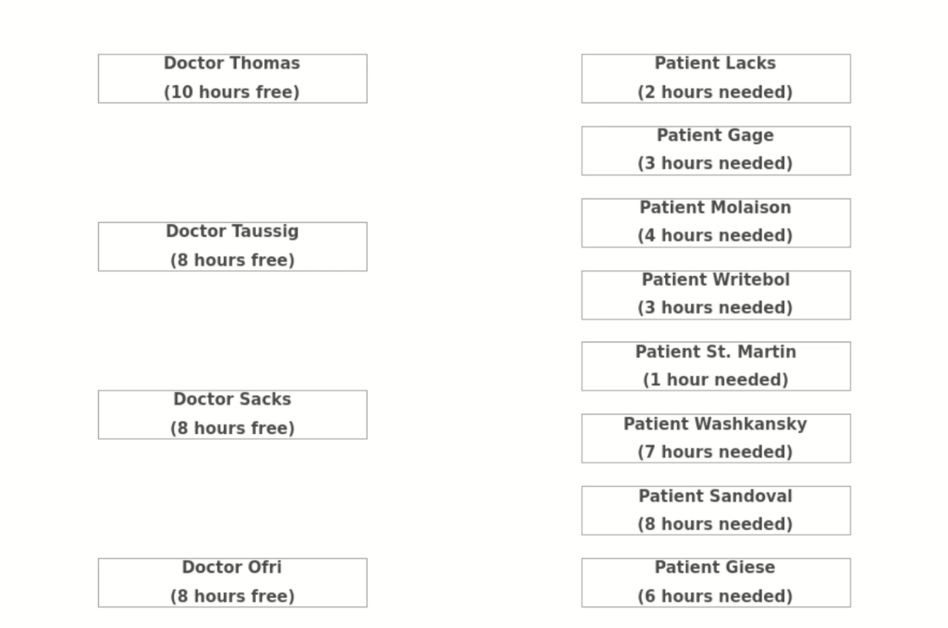

Slide 42
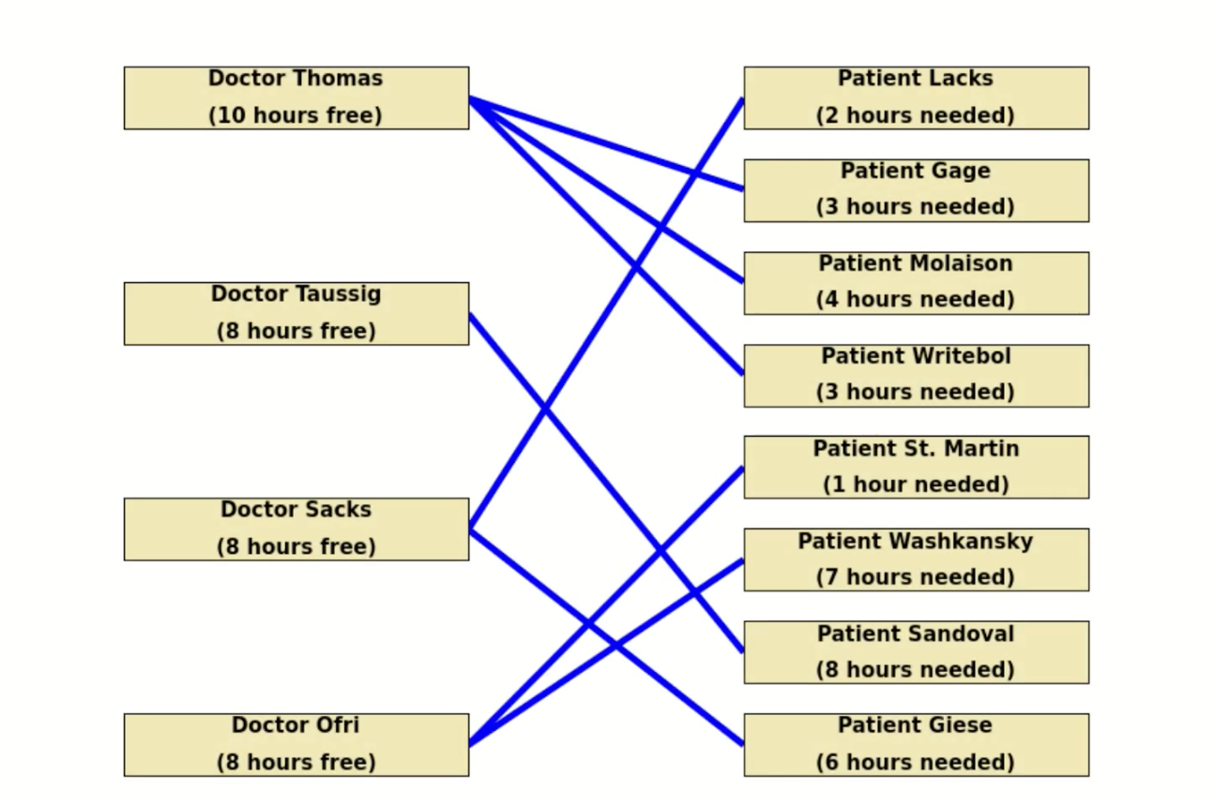
Notes:
This is a general resource allocation problem which can extend far beyond healthcare; however, I think health care is an inherently compelling use case.

Slide 43
Winning the Presidency

Slide 44


Slide 45
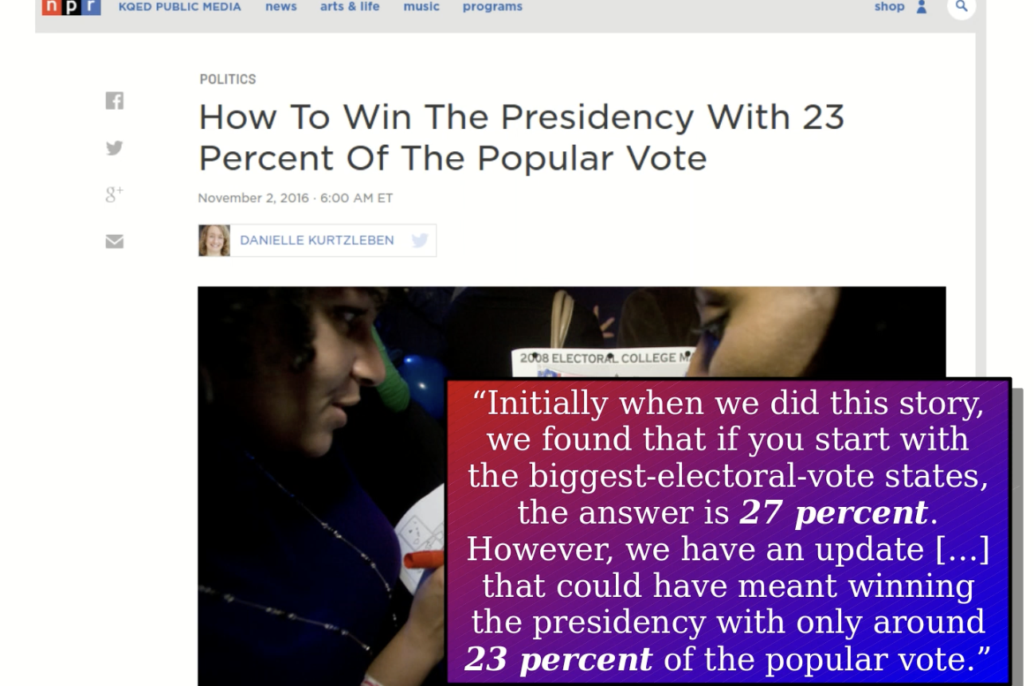

Slide 46
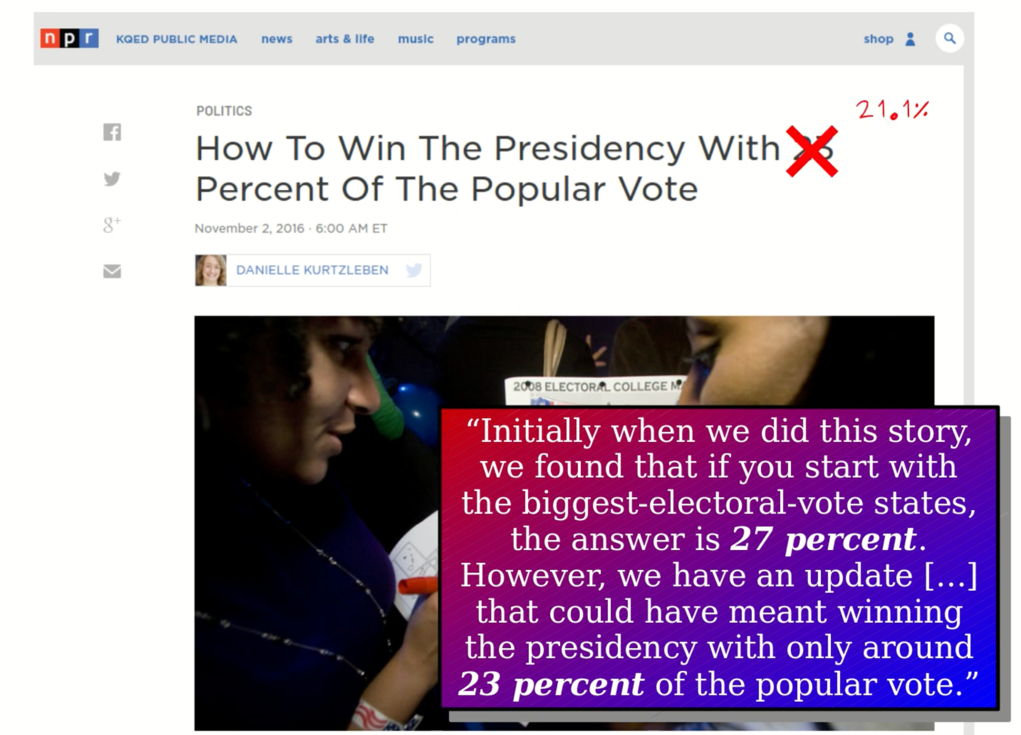

Slide 47
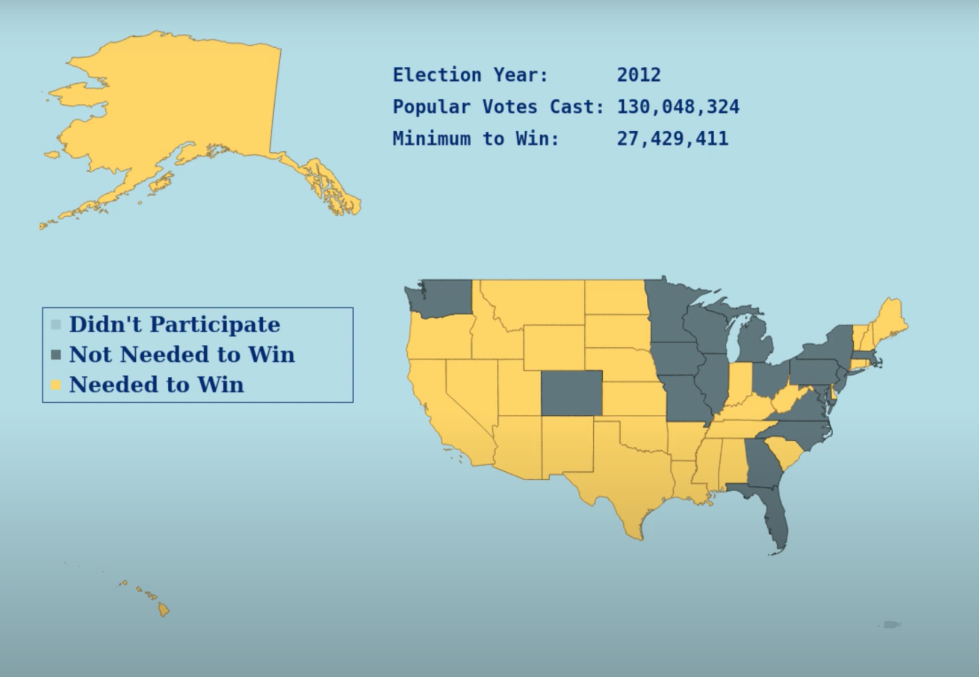

Slide 48
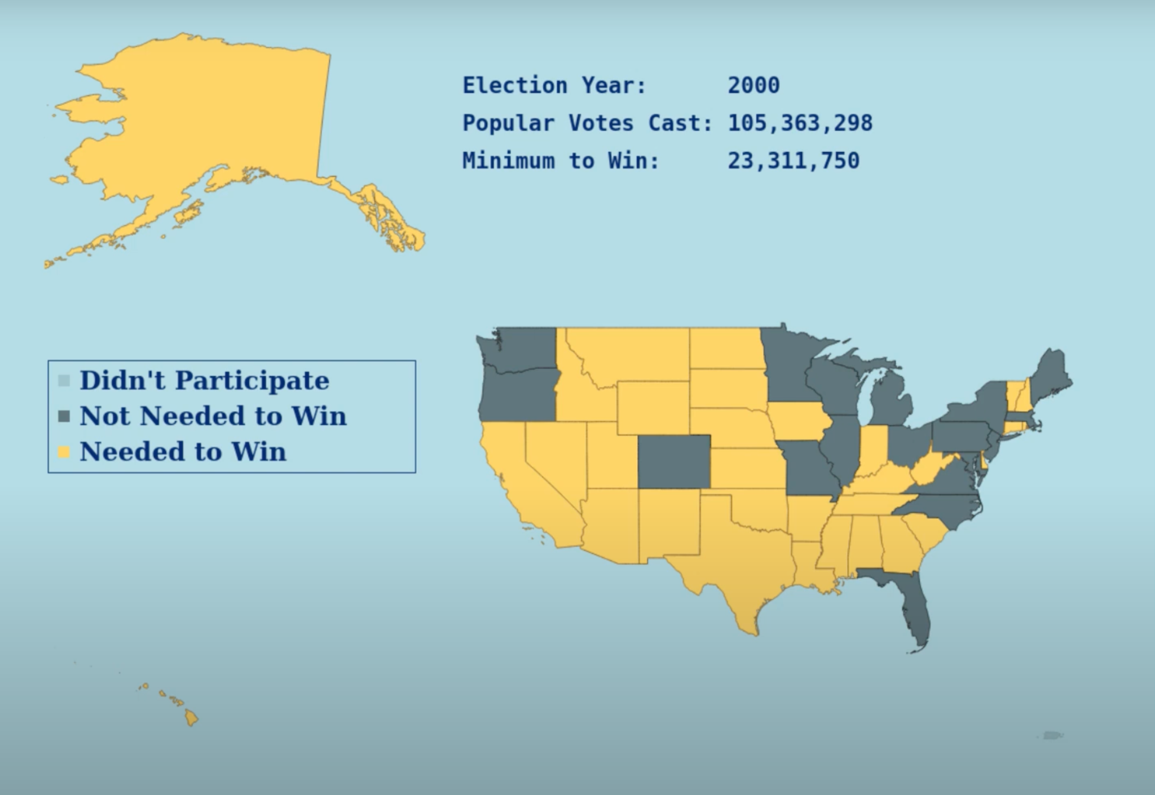
Notes:
This is an application of what’s known as the classic knapsack problem. The states have weights which is how many votes you need to carry the electors, the value associated with each state is the number of electors you’d win and the question is how much value you can carry with a limited amount of weight.
This problem is quite difficult to solve by hand and I know this because NPR got it wrong.. twice. But with the right algorithm, a computer can handle it seamlessly.

Slide 49

Our Guiding Questions…
1. Does it work?
2. Is it fast?
3. Can we do better?
Notes:
Over the entire course, we’re going to be looking at many different algorithms and I want us to approach each algorithm we come into contact with asking these questions: Does it work (critical), is it fast?, can we do better? By repeatedly asking ourselves this as we learn, we’ll build an algorithmic intuition that will serve us well in our future careers as engineers and computer scientists.

Slide 50
Big Questions!
08/18/22 - Session
Who are we?
Why are we here?
Where do we want to go?
What’s going on?

Slide 51

Course Logistics!
Course Website
comp285-fall22.ml
Lectures
Optional References
Homework
Exams
Piazza
Office Hours

Slide 52
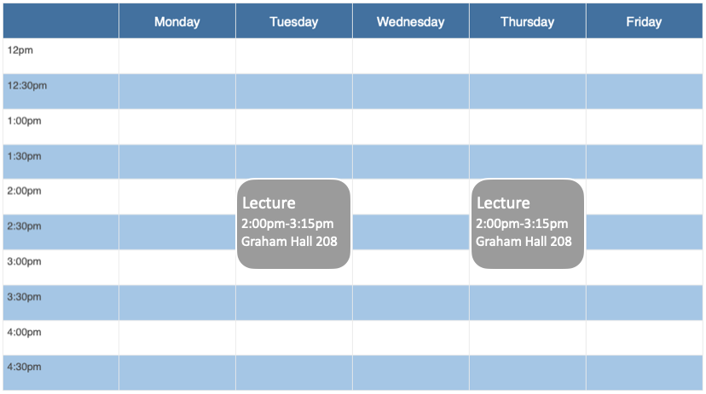
Lectures

Slide 53
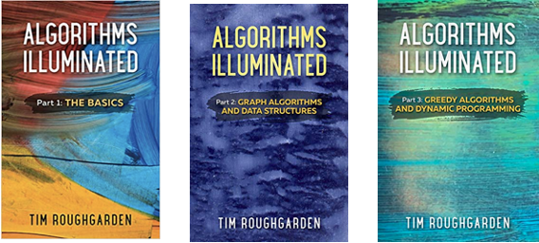
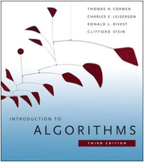
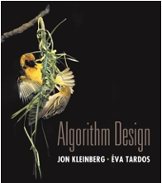
Optional References
Algorithms Illuminated, Vols 1,2 and 3 by Tim Roughgarden
Additional resources at algorithmsilluminated.org

Slide 54
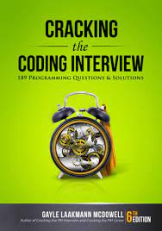

Required(-ish) References
Notes:
Cracking the coding interview; has anyone heard of this book? Okay so I’ll be sure to offer supplemental readings in this book; I really see this book as the conduit between the technical content we’re learning and the career prep module we’re imbuing the course with.

Slide 55
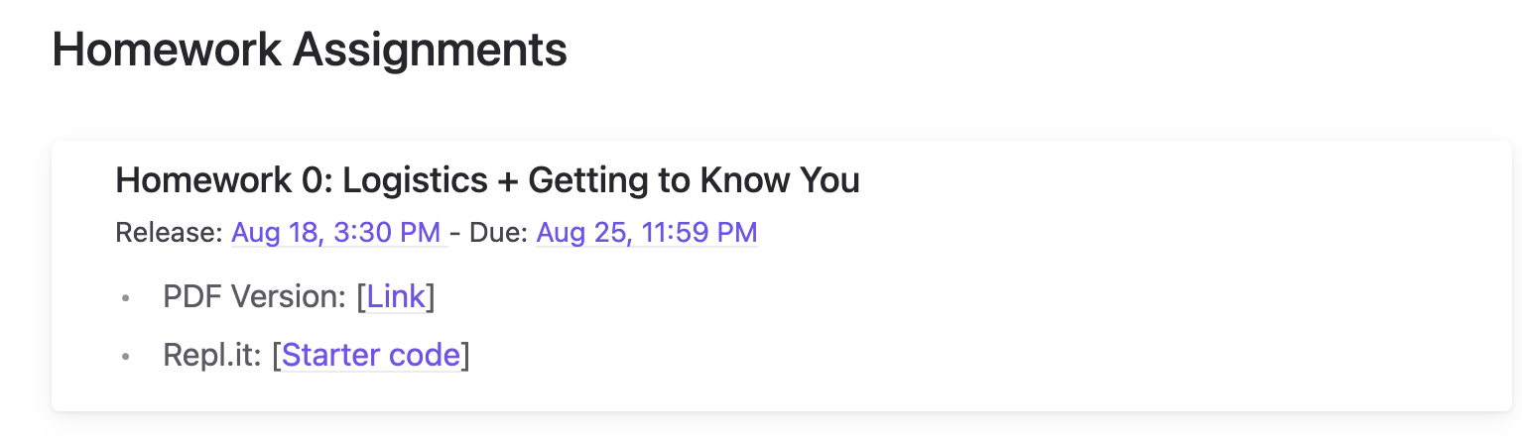
Homework (40%)
HW0 will be out today, due in 1 week @ 11:59pm ET
HW1 through HW9 have >7 day turnaround time
If released on Tuesday, due Thursday after next @ 1:59pm ET
If released on Thursday, due Tuesday after next @ 1:59pm ET
5-late day policy per assignment
Lowest HW score dropped w/ caveat
Notes:
This course used to have weekly homeworks, but there was feedback that the turnaround time got to be too tight so hoping this affords some extra breathing room. Aside from this intro assignment, you’ll have over a week to complete any one homework assignment.
Homework starter pack will be released on Repl.it. You are free to write solutions in an IDE of your choice, but everyone must register for

Slide 56
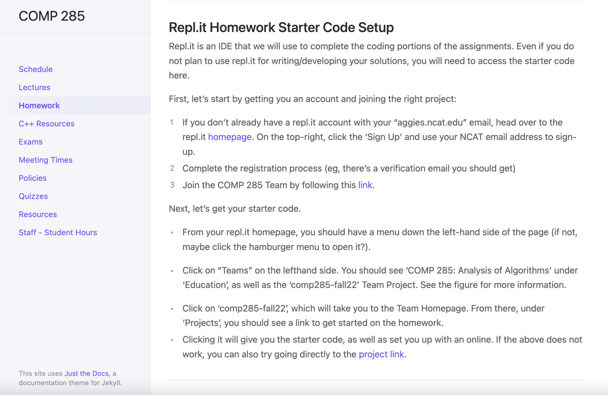
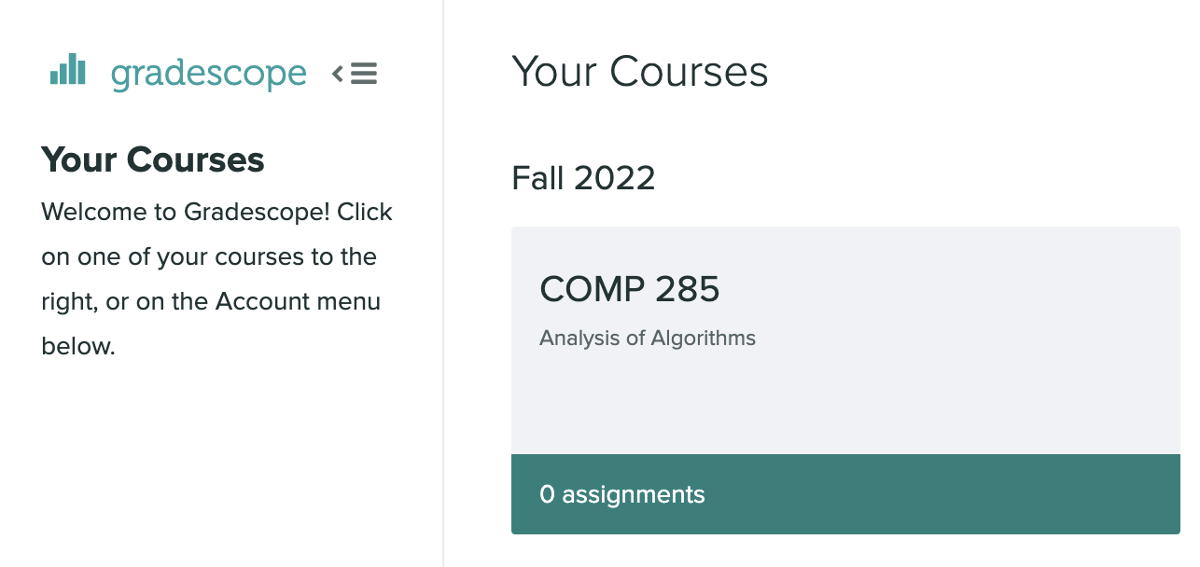
Homework (40%)
Notes:
Homework starter pack will be released on Repl.it. You are free to write solutions in an IDE of your choice, but everyone must register for Repl.it to access what they’ll need for each homework.
Luckily, the course website homework page has instructions for how to do so.
Any starter code will be written in C++.

Slide 57
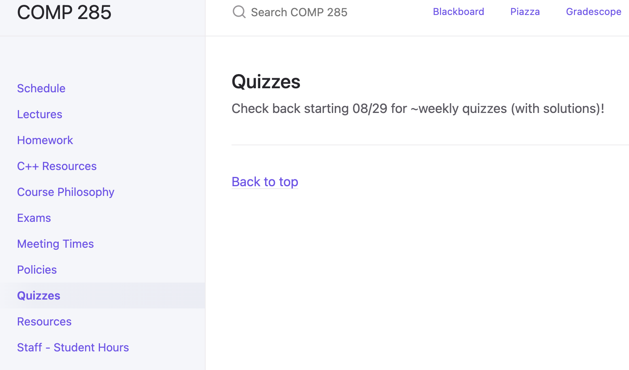
Quizzes (10%)
~Weekly quizzes starting 08/29
Quiz drop lowest 2 scores w/ homework caveat applied
Notes:
Quizzes…

Slide 58
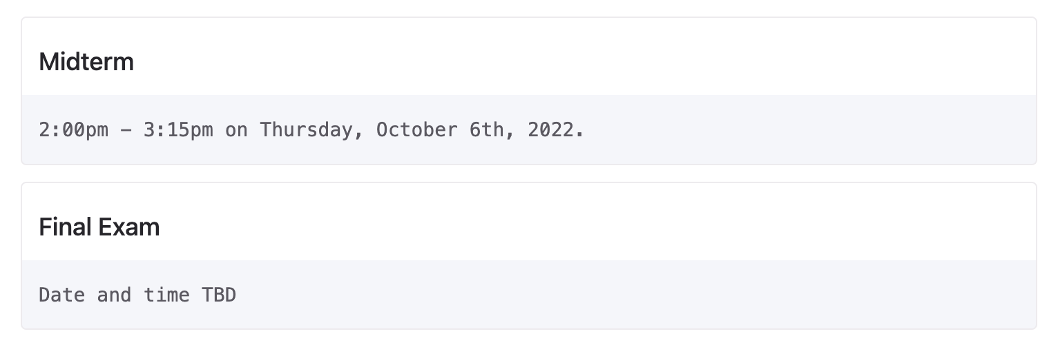
Exams (45%)
Notes:
We gotta have exams. Tried and true midterm and final.

Slide 59
In-class Participation (5%) /Extra Credit (~5%)
In-class participation:
Socratic method
Short exercises to be submitted
Extra credit opportunities:
Solving leetcode problems
Mock interview practice with teaching staff
Attending CS department events
Answering students’ questions on Piazza
Finding bugs in HW, quizzes, etc.

Slide 60
Piazza
Talk to us! Talk to each other!
Use Piazza!
(setup instructions in HW0)
https://piazza.com/class/l6fee1cmjpp5az
Link to enroll
Notes:
I’m just curious, have people used Piazza or heard of Piazza before?

Slide 61
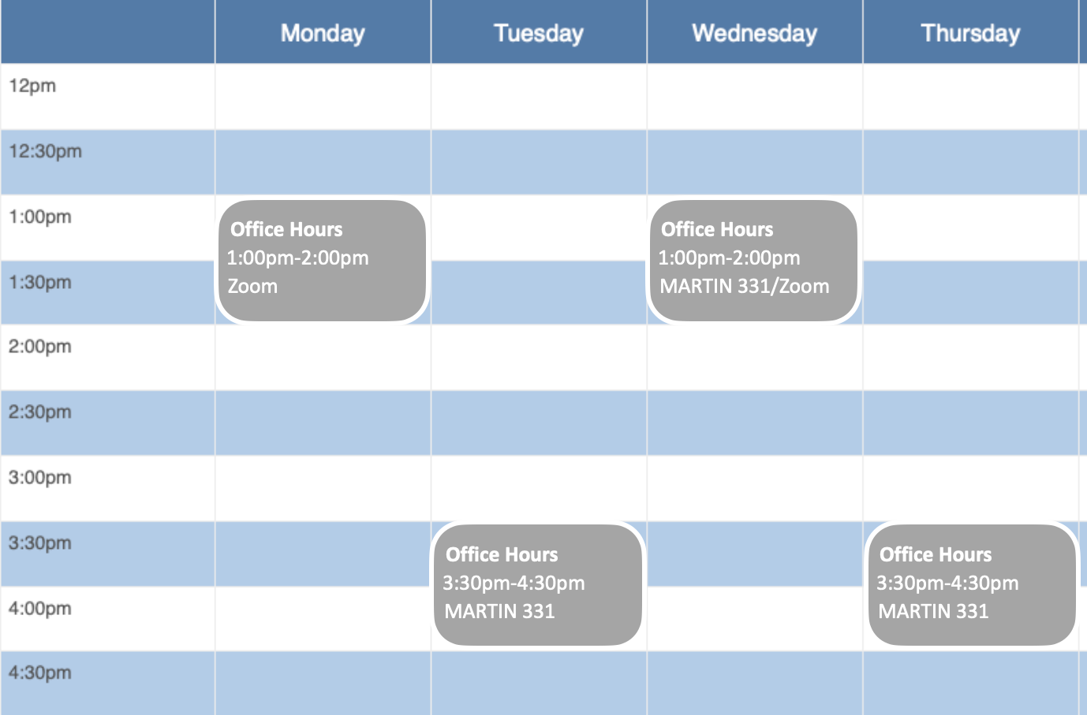
Office Hours
Notes:
This is the basic template for office hours; definitely after lecture on Tue/Thu, then I tried to pick alternative times for MW. In reality, this is just a base schedule; my door is always open, just use my calendly link that will be available on the course website to book time for whatever is on your mind. We will also augment this schedule with TA office hours as well.

Slide 62

Everyone can succeed!
Work hard!
Work smart!
Ask for help!
Notes:
Everything we just went over is available on the course website.
With all of these tools, resources, office hours, I hope that I hope it’s clear that I want everyone to succeed. We can all work together to work through challenging and ultimately rewarding material. I hope the flexible policies (dropping lowest scores for quizzes, assignments, participation, homework late days, etc.)
A. mitigate the need for one-off, individual accommodations since that’s not scalable from our end and
B. signal that we’re on the same team and that if you work hard, work smart, and ask for help when needed, your grade will be fine.
The teaching staff and I will support you each step of the way. My goal is to make each of you stronger students, engineers, and computer scientists.

Slide 63
Poll
Where can you find the most up-to-date info everything related to the course (logistics, announcements, resources, office hour schedules, etc.)?
Blackboard
Piazza
Gradescope
Course Website

Slide 64
Poll
Where can you find the most up-to-date info everything related to the course (logistics, announcements, resources, office hour schedules, etc.)?
Blackboard
Piazza
Gradescope
Course Website

Slide 65

Course Logistics!
Course Website
comp285-fall22.ml
Lectures
Optional References
Homework
Exams
Piazza
Office Hours
Notes:
Comp285-fall22.ml is the most important thing to come out of this logistics section of the lecture. Remember this website!

Slide 66
A few words on academic integrity
What are reasons that people cheat?
If you feel trapped or encouraged to cheat, please email instead to ask for help.
What counts as cheating?
Copying from another student or online sources (Stack Overflow, Quora, Chegg, etc.)
Providing written solutions to other students
Posting on Chegg or uploading material + solutions to CourseHero, Github, public Repl.it, etc.
You should never have someone else's solution in your possession
It’s not in your best interest to cheat.
Notes:
It’s not in your best interest to cheat - you’d essentially be shooting yourself in the foot so to speak for later courses that we discussed build upon this content, also your ability to go out into the world as a computer scientist or an engineer.
The last thing I’ll say about this is .. you know, we just spoke about how we’re using software to:
deploy autonomous driving technology, we use software
to diagnose cancerous v. benign tumors based on radiological scans and images,
we have robots performing certain surgeries now.
I don’t think any of us want to live in a world where the engineers of tomorrow (ie you) cut corners on their fundamentals.

Slide 67
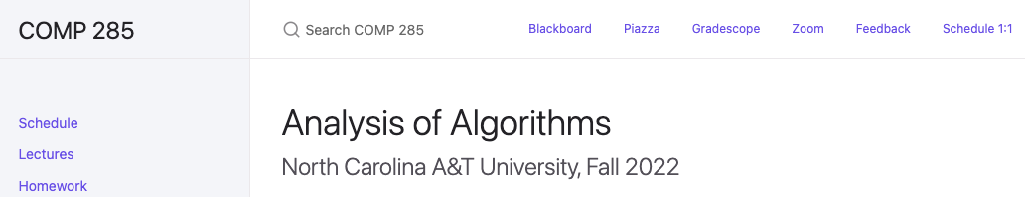
Feedback?

Slide 68
Anything else?

Slide 69
Tools for Success + Core Values
Notes:
We’re going to

Slide 70
Welcome Feedback
What this means for me:
What this means for you:
Will ask for feedback consistently over the semester
Will incorporate feedback into the classroom as it is given
Will give feedback to each student
Will receive feedback positively and seek to improve
Will constructively provide feedback on how we can all achieve our shared goals
Will share feedback with other students so we all may improve

Slide 71
Grit is essential
What this means for me:
What this means for you:
Will come to class prepared to deliver content in a meaningful, impressionable way
Will scale to meet students where they are and work to uplevel/challenge from there
Will show up class prepared to learn new material
Will show up to class with willingness to participate and maximize learning
Will see challenge as opportunity, understanding that optimal growth as engineers/computer scientists occurs in these instances

Slide 72
Comparison is the thief of joy
What this means for me:
What this means for you:
Will ensure career coaching, 1:1 office hour conversations, etc. are tailored to the individual student
Offer my individual perspective, realizing it is only one perspective, while accommodating other perspectives
Will remain focused on oneself, what one as an individual needs to do next in order to succeed (in their own terms)
Will abstain from comparing progression/trajectories among peers
Remain able to seek inspiration from those around you

Slide 73
Goals are Golden
What this means for me:
What this means for you:
Will incorporate applications of course content to answer “why are we learning this“, “why is this important”
Will prioritize orienting content in a way that facilitates students achieving their short- and long-term goals.
Will create time and space for honest reflection of short- and long-term goals and why COMP 285 fits into that picture
Will use these goals as motivation/fuel to propel through the course
Notes:
I think that’s all of the logistics, bookkeeping, administrative, and vision setting stuff we need to discuss to lay the foundation.
PAUSE FOR QUESTIONS
I think we’re ready to jump into some content. We’re going to look at an algorithm that you’re very familiar with and is very tried and true. It’s not the first algorithm you ever learned but it’s definitely one of the earliest.. And that’s …

Slide 74
Big Questions!
08/18/22 - Session
BONUS!
Who are we?
Why are we here?
What’s going on?
Where do we want to go?
Remember how to multiply?
Notes:
How to multiply integers… I know it doesn’t sound like the sexiest algorithm or most interesting, though to me, once we dig a bit beneath the surface it gets pretty interesting.

Slide 75
Big Questions!
08/18/22 - Session
BONUS!
Who are we?
Why are we here?
What’s going on?
Where do we want to go?
Remember how to multiply?
Notes:
Before that though, remember Goldilocks?

Slide 76

Big Questions!
08/18/22 - Session
BONUS!
Who are we?
Why are we here?
What’s going on?
Where do we want to go?
Remember how to multiply?
Notes:
Slurping up the three bears’ porridge? Believe it or not, this crafty wench is going to help us learn about algorithmic runtime.

Slide 77
Notes:
Goldilocks breaks into the bear’s den. She’s is a hungry girl, she’s gotta eat. She looks over

Slide 78
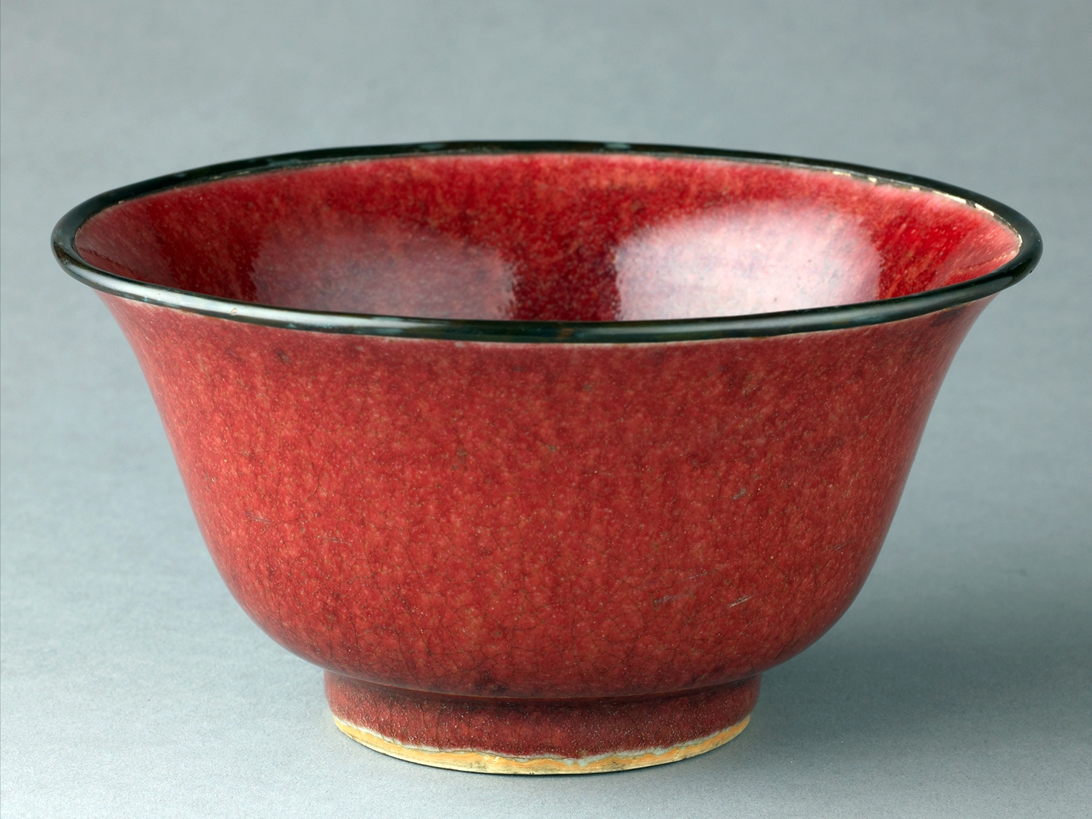
x
Notes:
at baby bear’s bowl of porridge, x amount of food, … she goes to town on it and devours it in 5 seconds.

Slide 79
5s
x
Notes:
and devours it in 5 seconds. She’s still hungry…. And so she looks over at

Slide 80
5s
x
2x
Notes:
Mama bear’s bowl of porridge… so it’s twice as large as baby bear’s bowl. But the bigger bowl doesn’t stand a chance against our sweet Goldilocks,

Slide 81
5s
5s
x
2x
Notes:
, and she takes it out in 5 seconds too. Lastly, Goldilocks is still hungry… somehow and

Slide 82
5s
5s
x
2x
3x
Notes:
peers over at papa bear’s gargantuan bowl of food. Three times the amount of baby bear’s food. You’d think she’d slow down, but alas,

Slide 83
5s
5s
5s
x
2x
3x
Notes:
She bodies that thing in 5 seconds… Now, this tells us something very interesting about Goldilocks’s uncanny ability to consume porridge. What’s notable about this scenario, specifically the time it takes her versus the amount of food she must eat?
The time she took to eat remained constant despite the bowl getting larger and larger.

Slide 84
15s
10s
5s
x
2x
3x
Notes:
What about this? As the size of the bowl increases or one could say as the size of the task at hand increases, her time increases too. More specifically linearly…

Slide 85
?s
20s
5s
x
2x
3x
Notes:
Lastly, this is probably the most realistic example, right? She eats baby bear’s bowl in 5s, she has a reasonably sized stomach in this example, so mama bear’s is taking her longer… it’s taking her 20 seconds (she’s already getting full). By the time she gets to papa bear’s bowl, she’s nearly comatose trying to get through that bowl of porridge. How long do we think it will take Goldilocks to eat this porridge? 45 seconds,

Slide 86
45s
20s
5s
x
2x
3x
Notes:
45 seconds, What would we call this? The time it takes her to eat is growing at a quadratic rate
We’re interested in the mindset of: how does the time it takes Goldilocks to eat increase as the amount of food I give her increases. At what rate does the time taken increase as the input increases.

Slide 87
Announcements
Sign up for CodePath! application due Sunday, August 21st, 2022
Great preparation for technical interviews and recruiting!
Mock interviews w/ Meta Oct 10th-13th
For practice and feedback only; performance is not documented anywhere!
Sign ups will go live mid-Sept.
HW0 is OUT!

Slide 88
Wrap-Up
comp285-fall22.ml
Algorithms are fundamental, useful and fun!
Does it work? Is it fast? Can we do better?
We’ll develop algorithm intuition and tech chops (helps with interviews!). As such, We’re continuing to invest in career prep

Slide 89
Next time!
Career prep step #1 - Resumes!
Karatsuba multiplication
Recursion, recursion, recursion
Notes:
Really looking forward to meeting each of you, learning about you, and I look forward to our semester together. Thanks!

Slide 90
Welcome to COMP 285
Lecture 0: Welcome + Course Logistics
COMP - 285
Advanced Analysis of Algorithms
Chris Lucas (cflucas@ncat.edu)

